Slide 1


JAVA PROJECT BATCH
GUI Programming
Lecture-4

Slide 2
Today’s Agenda
01
Swing Programming in Java
02
Introduction
03
JFrame class
05

Slide 3
Developing Swing Programming
Developing Swing Programming
The “JFrame” Class: Just like we have Frame class in awt similarly we have the
JFrame class in swing.
As usual we use the JFrame class to create the main window of our application.

Slide 4
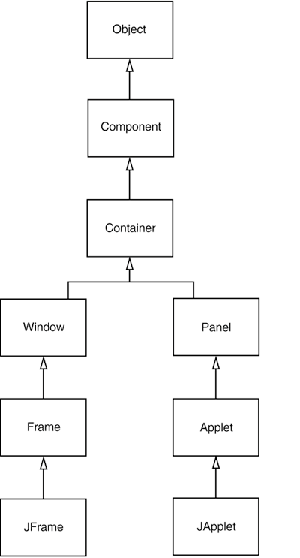
Inheritance Hierarchy Of JFrame
Developing Swing Programming

Slide 5
The “JFrame” class
Constructors of “JFrame”:
public JFrame()
public JFrame(String title)
Method of “JFrame” class:
All methods of “Frame” + 3 more methods
public void setIconImage(Image)
public void setDefaultCloseOperation(int)
public Container getContentPane()
Arguments which can be passed to setDefaultCloseOperation() method:
JFrame.EXIT_ON_CLOSE
JFrame.DO_NOTHING_ON_CLOSE
JFrame.DISPOSE_ON_CLOSE
JFrame.HIDE_ON_CLOSE

Slide 6
Example
Develop a JFrame based application to create a JFrame of 400*400 size with your name displayed in the title bar

Slide 7
Solution
import javax.swing.*;
import java.awt.*;
class UseJFrame
{
public static void main(String [] args)
{
JFrame jf=new JFrame(“Sachin’s JFrame”);
jf.setSize(400,400);
jf.setVisible(true);
jf.setDefaultCloseOperation(JFrame.EXIT_ON_CLOSE);
}
}

Slide 8
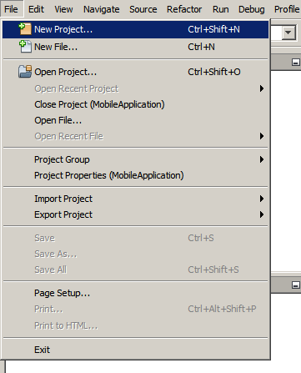
Creating GUI Using GUI Builder
To create an IDE project:
1. Start NetBeans IDE.
2. In the IDE, choose File > New Project, as shown in the figure below.

Slide 9
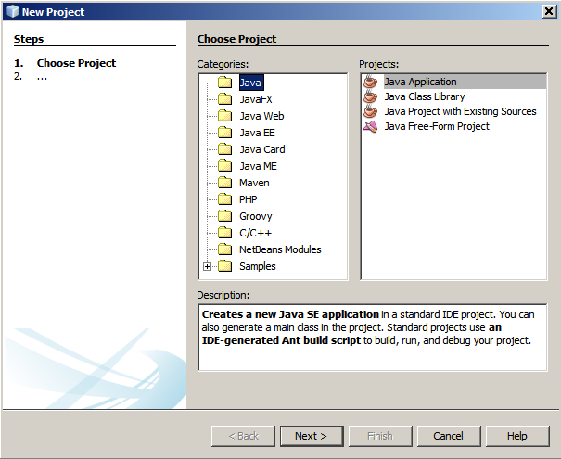
Creating GUI Using GUI Builder
3. In the New Project wizard, expand the Java category and select Java Application as shown in the figure below. Then click Next.

Slide 10
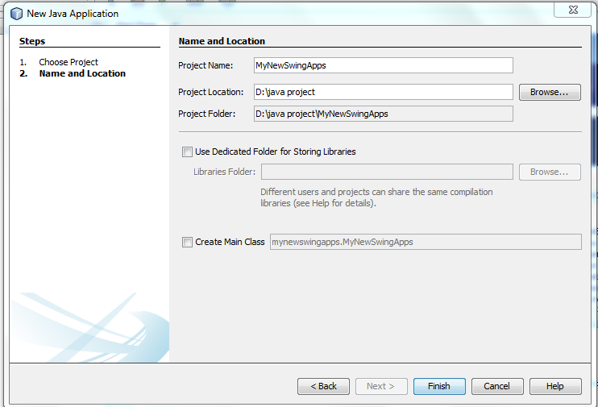
Creating GUI Using GUI Builder
4. In the Name and Location page of the wizard, do the following (as shown in the
figure below):
In the Project Name field, type MyNewSwingApps.
Save it in D drive by creating a folder name as java project,Project
Location: D:\java project
Uncheck the Main Class field.
And then click on finish.

Slide 11
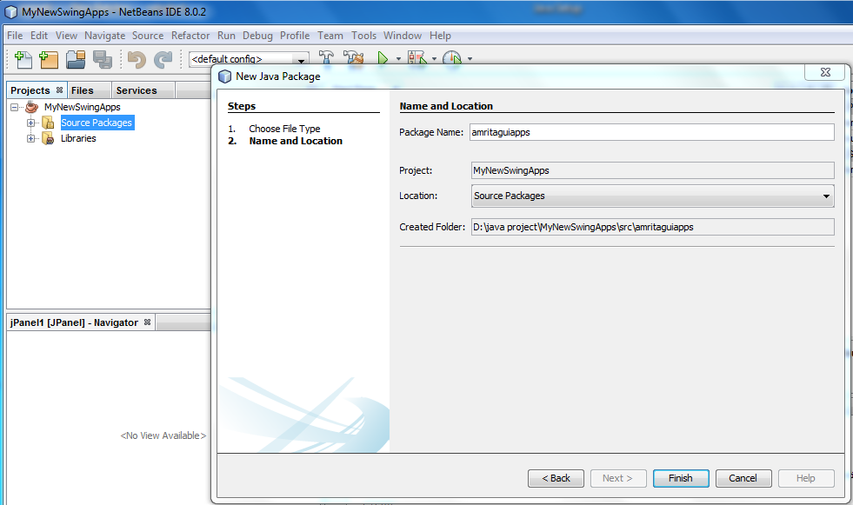
Creating GUI Using GUI Builder
5.Now create a package by right clicking on source package,type Package
name: amritaguiapps,then click on finish.

Slide 12
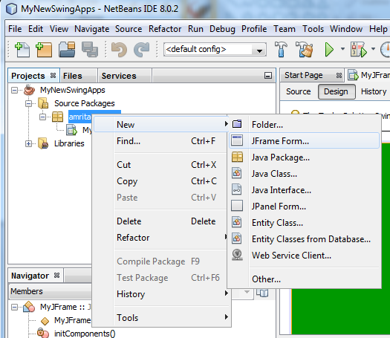
Creating GUI Using GUI Builder
6. Now to create a JFrame right click on source package:amritaguiapps →
New→JFrame Form.

Slide 13
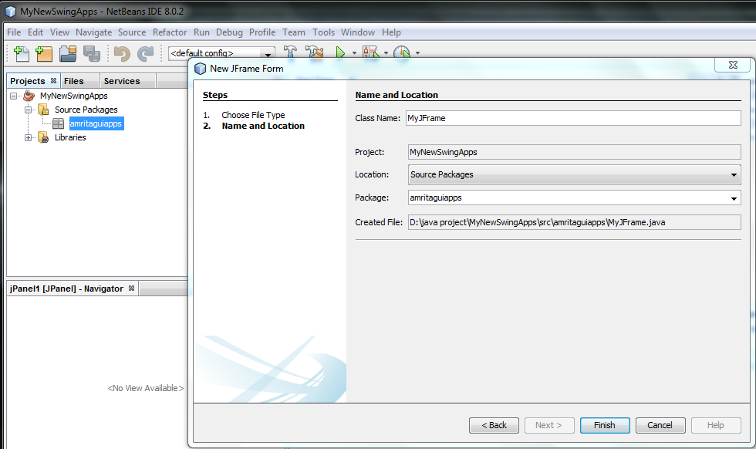
Creating GUI Using GUI Builder
Class Name: MyJFrame then click Finish.

Slide 14
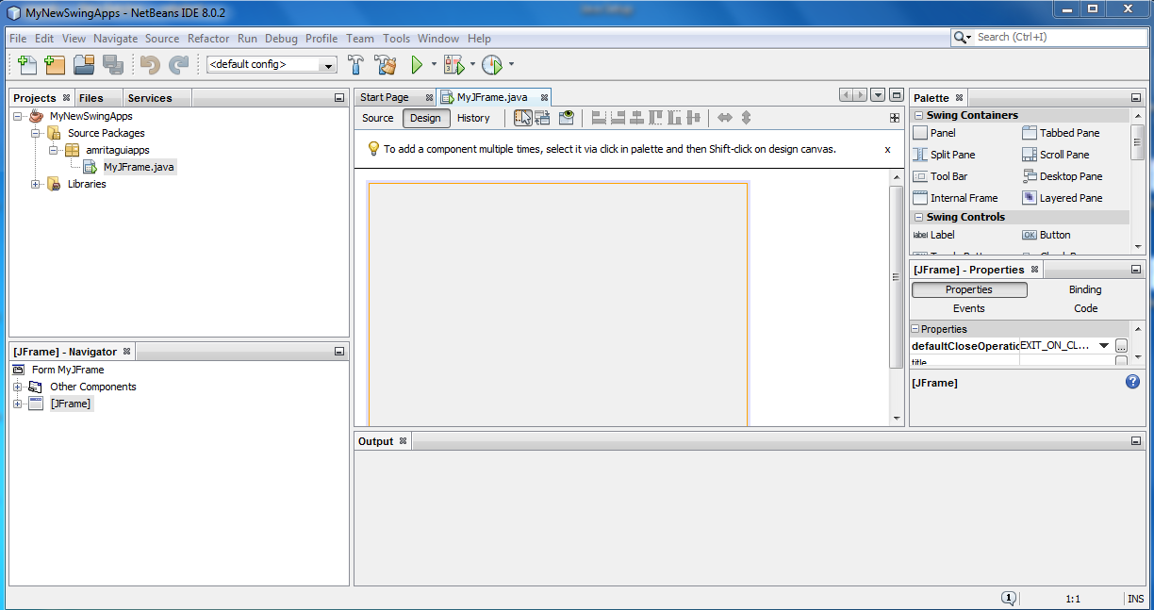
Creating GUI Using GUI Builder
It will look like this:

Slide 15
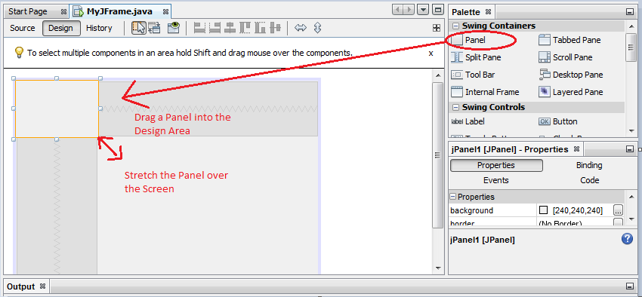
How to Add a Panel to Frames
How to Add a Panel to Frames
Adding the Background color is just the matter of few drags and drops. Open the Jframe
windows, drag the Panel from the Palette which is located in the upper right corner to
the Design area.

Slide 16
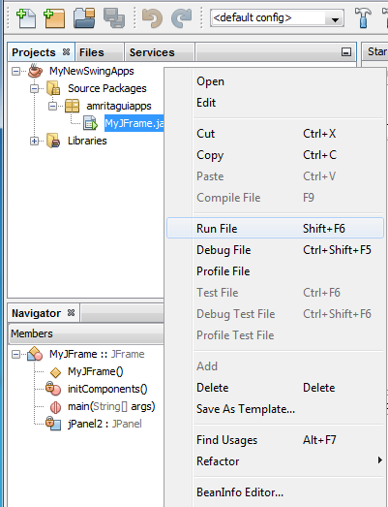
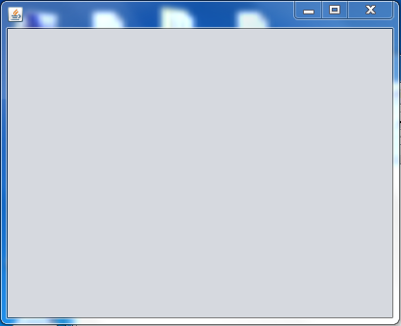
Run the Project
Run the project:
To run the project right click on
Jframe and click on Run File.
After click on Run File the output window look like this.

Slide 17
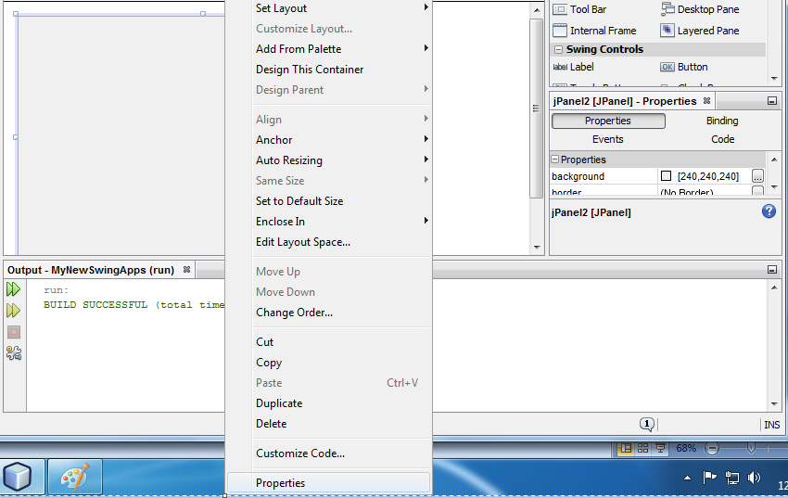
How to add Background Color to JFrame
To add background color of JFrame right click on JFrame, then click on
properties as shown below:

Slide 18
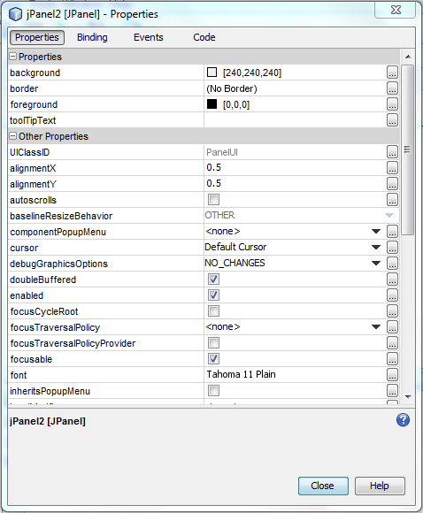
How to add Background
Color to JFrame
Now click on Properties→background →Close ,as shown below:

Slide 19
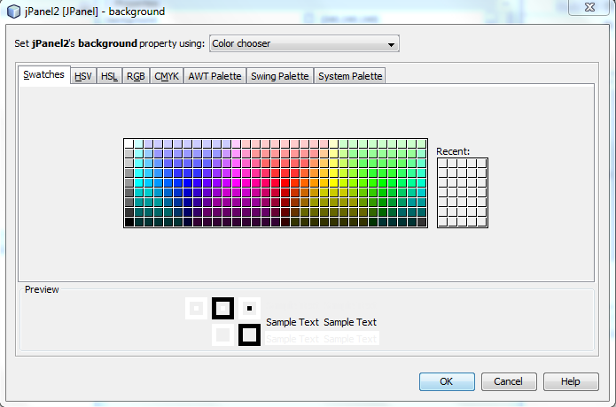
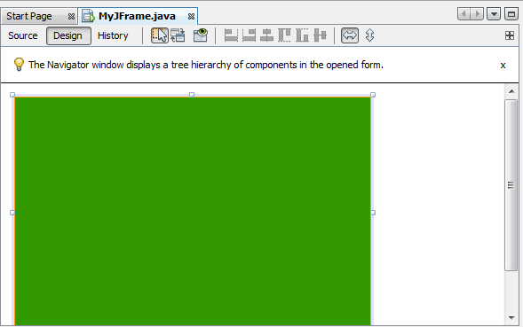
How to add Background
Color to JFrame
Choose a color and then click on OK.
Finally it look like this:

Slide 20
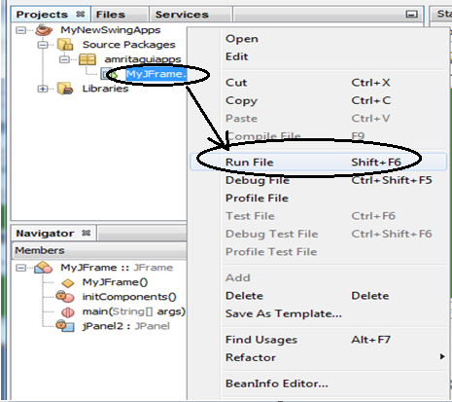
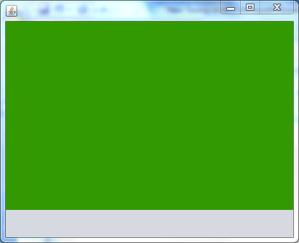
How to add Background
Color to JFrame
To Run the Project right click on MyJFrame.java then click on Run File, the output look like this :
Output Window

Slide 21
Thank you

